Slide 1
Optimizing Street
Team Engagement
Fahimeh Khalegi ● Shivaji Dutta ● Tahmid Chowdhury
WomenTechWomenYes
April 5, 2019

Slide 2
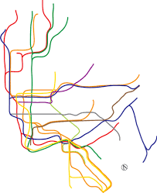
Goal
Optimize the collection of signatures and attendance for the Women Tech Women Yes annual gala

Slide 3
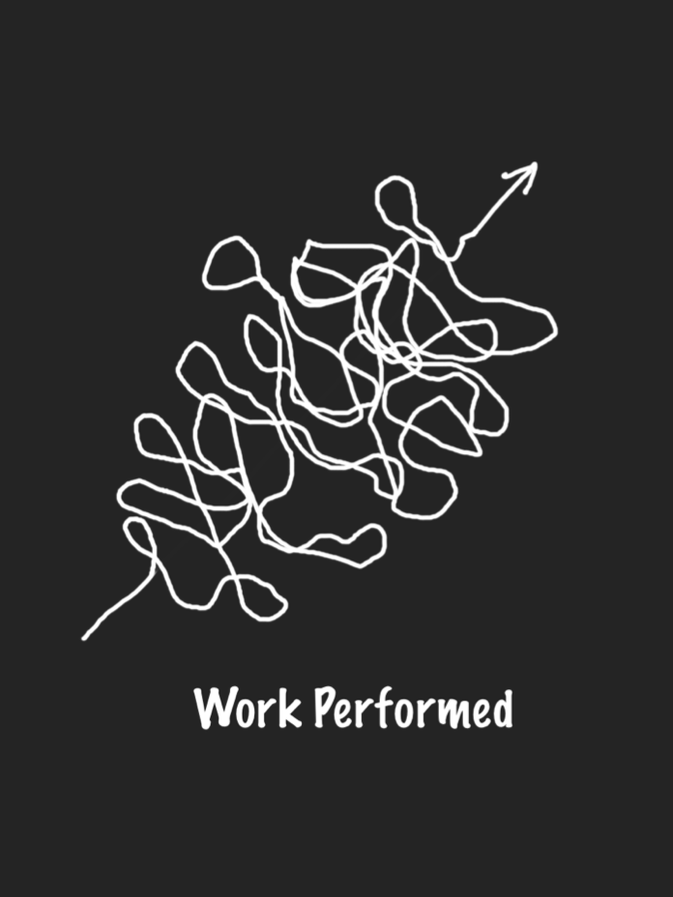
Methodology
Notes:
Mention what we used for analysis (logos on the bottom). We considered other assumptions to factor into our recommendations, such as density of tech companies and universities near subway stations,

Slide 4
Methodology
TOP
10
DATA
ANALYSIS
PRELIM RESULTS
Notes:
Mention what we used for analysis (logos on the bottom). We considered other assumptions to factor into our recommendations, such as density of tech companies and universities near subway stations,

Slide 5
Results
Top 10 most trafficked stations
Notes:
Out of hundreds of stations in NYC, we’ve narrowed it down to 10

Slide 6
Results

Slide 7
Results
Highest concentration of tech companies:
Garment District
Greenwich Village
Financial District
Notes:
Based on an analysis Fortune Magazine did on the NYC Office of the Mayor data on tech companies in NYC,

Slide 8
Results
Two out of ten tech-focused
universities are in NYC

Slide 9
Results
23rd Street
Canal Street
Chamber Street

Slide 10
Results
23rd Street

Slide 11
Results
23rd Street

Slide 12
Recommendations
Send street team members to the following stations:
23rd Street at noon, 4pm and 8pm
Canal Street 9am, 4pm and 8pm
Chamber Street noon, 4pm and 8pm

Slide 13
THANK
Fahimeh Khalegi
fahimeh1278@gmail.com
Shivaji Dutta
shivaji@aurius.io
Tahmid Chowdhury
tahmid.chowdhury@gmail.com
YOU!

Slide 14
Appendix
10,346,286
records
Cleaning plan
Scraped MTA website for 2 years of .txt files and combined into one .csv
Checked for null values and discrepancies in spelling
Drop TIME values with seconds other than :00
Converted DATE and TIME objects to datetime
Reviewed describe function
Took difference between rows to avoid having to use cumulative amounts

